Slide 1
How the web works? Some basic concepts you need to know
Notes:
This slide contains concepts so lecturer ask students to discuss the the related problems for excercise

Slide 2
Objectives
History of world wide web
Web application architecture
Some basic concepts: IP address, Domain Name System and default URL, Client-Server Architecture, Server, Web Server, Database Server, Static/Dynamic Web…
Introduction of website development technologies
Some applications, which typically run on server

Slide 3
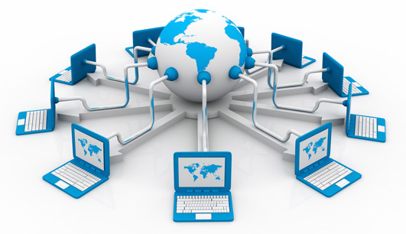
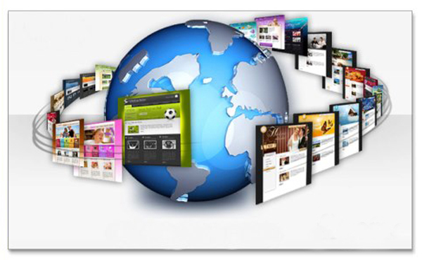
The Internet Versus the Web
The Internet
is a network of connected computers in the world
no company owns the Internet
governed by a system of standards and rules
There are many ways information can be passed between computers, including email, file transfer (FTP), and many more specialized modes upon which the Internet is built. These standardized methods for transferring data or documents over a network are known as protocols
The Web
is just one of the ways information (or other things) can be shared over the Internet
allows documents to be linked to one another using hyper links
The Web uses a protocol called HTTP
Notes:
What other things? => Cloud, Internet of Things
What other protocols do you know? (FTP, SMTP, HTTPS, POP, TCP/IP)

Slide 4
A Brief History of the Web
The Web was born in a particle physics laboratory (CERN) in Geneva, Switzerland in 1989. Tim Berners-Lee devised a method for navigating between files using
Hyperlink Framework (is later called HTTP)
Hyper Text Markup Language (HTML)
Web browser and web server
For the first several years, web pages were text-only.
The ongoing development of web technologies is overseen by the World Wide Web Consortium (W3C).
W3C’s History Archives
www.w3.org/History.html

Slide 5
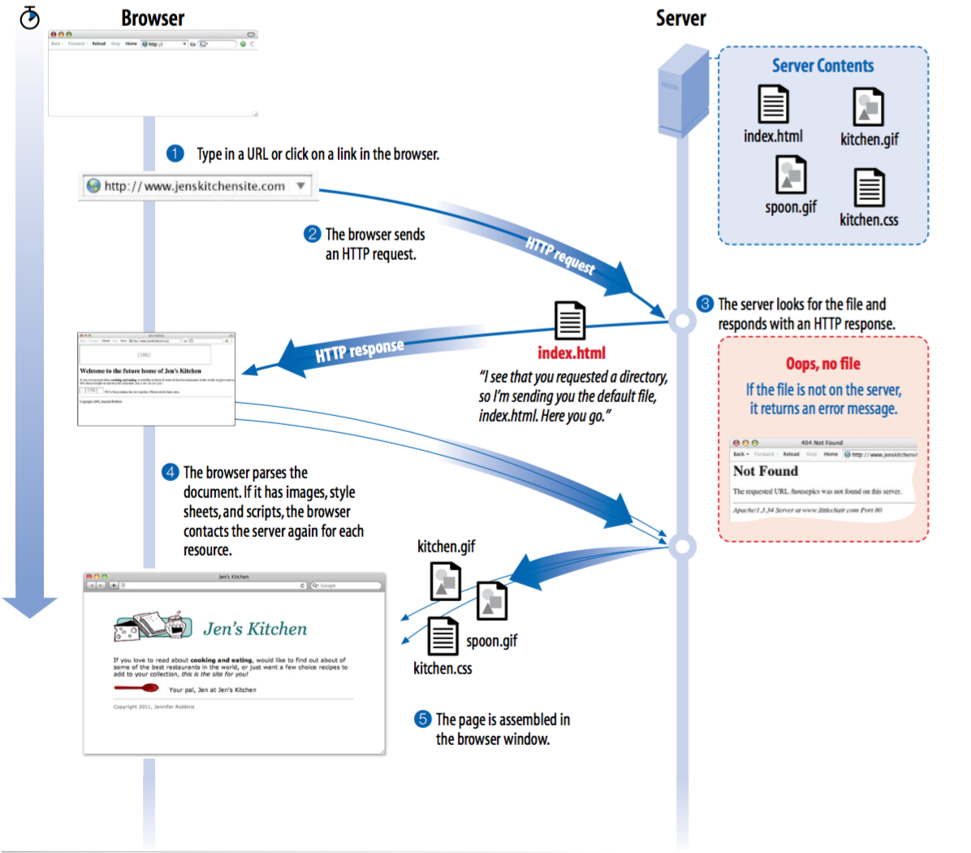
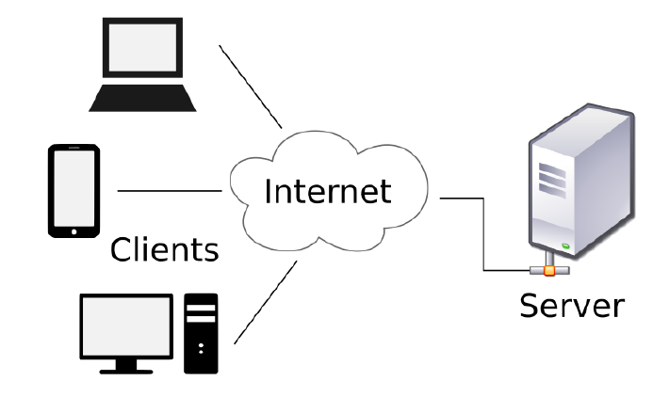
How the web works

Slide 6
How the web works
The computers that make up the Internet, “serve up” documents upon request are known as servers. More accurately, the server is the software (not the computer itself) that allows the computer to communicate with other computers.
The role of server software is to wait for a request for information, then retrieve and send that information back as quickly as possible.
In order for a computer to be part of the Web, it must be running special web server software that allows it to handle Hypertext Transfer Protocol transactions. Web servers are also called “HTTP servers.”

Slide 7
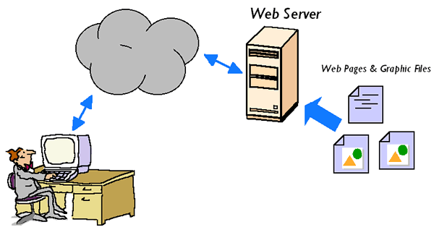
Web server
The server is the software (not the computer itself) that:
allows the computer to communicate with other computers
waits for a request for information, then retrieve and send that information back as quickly as possible
This software is installed In the actual computer, which is installed server operating system and called host
Notes:
What kind of other servers do you know?
(File server, Database server, Domain Name server, Mail server …)

Slide 8
Most popular web server
Apache: ​One of the most popular web server in the world developed by the Apache Software Foundation. Apache is an open source software which supports almost all operating systems including Linux, Unix, Windows, FreeBSD, Mac OS X and more
IIS (Internet Information Services) is a Microsoft product. This server has all the features just like apache. But it is not an open source and more over adding personal modules is not easy and modification becomes a little difficult job.

Slide 9
Domain Name System (DNS)
Every computer and device (modem, router, smartphone, cars, etc.) connected to the Internet is assigned a unique numeric IP address (IP stands for Internet Protocol)
For example, the computer that hosts oreilly.com has the IP address 208.201.239.100
All those numbers can be dizzying, so fortunately, the Domain Name System (DNS) was developed to allow us to refer to that server by its domain name, “oreilly.com”, as well
The numeric IP address is useful for computer software, while the domain name is more accessible to humans. Matching the text domain names to their respective numeric IP addresses is the job of a separate DNS server.

Slide 10
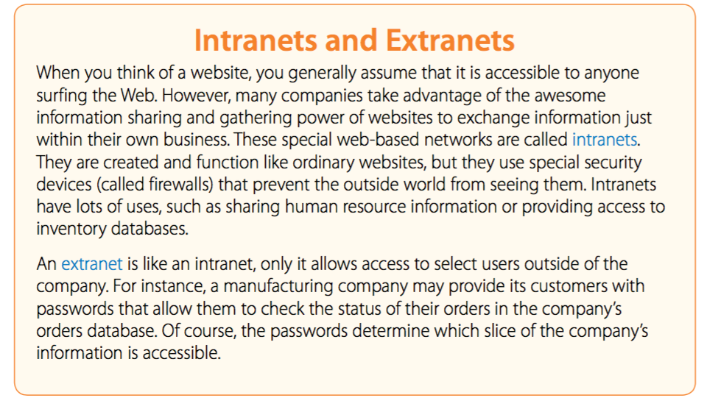
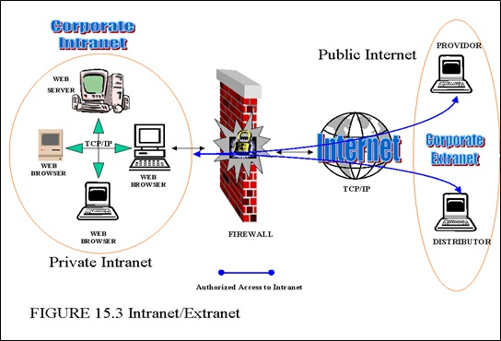
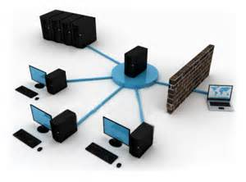
Intranets and Extranets
Notes:
An extranet requires security and privacy. These can include firewall server management, the issuance and use of digital certificates or similar means of user authentication, encryptionof messages, and the use of virtual private networks (VPNs) that tunnel through the public network.

Slide 11
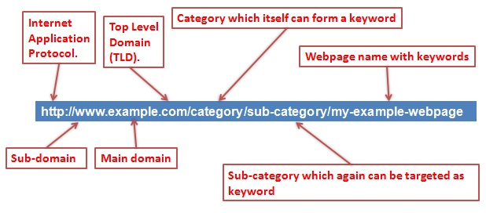
Web Page Addresses (URLs)
URL’s parts
Default files
http://www.oreilly.com/index.html
http://www.jendesign.com/resume/index.jsp
http://www.cms.greenwich.edu.vn/index.php
Notes:
How many top level domain do you know?
.com, .org, .net, .gov

Slide 12
The role of HTML/CSS/JS
W3C is an organization that maintains the standards of technologies used to develop web pages and web sites.
HTML is a Hypertext Markup Language
HTML allows the web designers to create various web sites.
CSS (Cascading Style Sheets) is created to separate the structure and presentation of an HTML.
JavaScript is the programming language of HTML and the Web.
Programming makes computers do what you want them to do.
JavaScript is easy to learn.

Slide 13
A small HTML example
<!DOCTYPE html> <html> <head> <title>Page Title</title> </head> <body> <h1>My First Heading</h1> <p>My first paragraph.</p> </body> </html>
Try it Yourself

Slide 14
Server operation system
Server OS is an operating system specifically designed to run on servers, which are specialized computers that operate within a client/server architecture to serve request of client on the network
Type of Server OS:
Windows server (2000, 2003 R3, 2008…)
Unix (Red Hat)
Mac OS X Server
Some applications, which typically run on server
Web server
Database server
Mail server
DNS server

Slide 15
Some applications, which typically run on server
Web server: Hosts web pages. A web server is what makes the World Wide Web possible. Each website has one or more web servers.
Database server: Maintains and shares any form of database (organized collections of data with predefined properties that may be displayed in a table) over a network.
Mail server: Makes email communication possible in the same way that a post office makes snail mail communication possible
DNS: is a hierarchical decentralized naming system for computers, services, or other resources connected to the Internet or a private network

Slide 16

A Word About Browsers
State what a web browser can do?
…
...
...
...
Some popular web browser
Internet Explorer
Firefox
Safari
Opera
Chrome
Notes:
Ask students to discuss
Static web page
Dynamic web page: multimedia
Play game
Programming
Word/Excel/Powerpoint editor
Email
Manage database
Graphical design

Slide 17
HTTP
Hypertext Transfer Protocol
Set of rules about the content/format and sequence of messages for requesting/responding Web pages
A communication standard
Governing the requests and responses between browser and the web server
The client makes a request for a page
The server is to accept request from client and serve a page

Slide 18
Static web
Static web
Made with HTML
Pages of text and graphics with hyperlinks to navigate from one to another
Limitations
Difficult to maintain.
Updated manually.
Inconsistency.
Don’t allow any user interaction.
The results didn’t meet the needs of each user with dynamically changing content

Slide 19
Dynamic web
Dynamic web
Allows customizing the content and its appearance in the browser.
Generates content “on-demand”.
Accepts the user inputs through web browser.
Several technologies evolved to make web sites more flexible and dynamic.
Variety device such as PDAs, Cell phones, and so on is used XHTML Documents

Slide 20
Static & Dynamic website

Slide 21
Web application architecture

Slide 22
Server-side Scripting Language
Dynamic web server are often created with server-side languages
Examples: Perl, PHP, Ruby, etc
They use Common Gateway Interface (CGI) to produce dynamic web pages

Slide 23
Client-side scripting language
Client-side scripting is changing interface behaviors within a specific web page
In response to mouse or keyboard action, or at specified timing events
The dynamic behavior occurs within the presentation
The client-side content is generated on the user’s local computer system

Slide 24
Server-side dynamic web page
It is a web page whose construction is controlled by an application server processing
In server-side scripting
Parameters determine how the assembly of every new web page proceeds
Including setting up of more client-side processing
Why do we need scripting language for the server side?
HTML is for displaying purpose only
It’s not capable of complicated business processing (accessing to files, database, network, etc.) -> why not? -> Security.

Slide 25
Server-side dynamic web page with PHP
Accessing this page at different time you will have different result

Slide 26
Client-side dynamic web page
It processes the web page using HTML scripting running in the browser
Client scripting language (e.g., JavaScript) determine the way HTML in the received page is parsed into the Document Object Model (DOM)
DOM represent the loaded page
The client-side techniques can dynamically update or change the DOM

Slide 27
Client-side dynamic web page with JavaScript

Slide 28
Some server-side scripting technologies
PHP: usually be used to develop web application, which can run on Apache server. But now, IIS also supports PHP. Web applications developed by php languages includes files in .php extension
ASP.Net: developed by Microsoft. This technology uses .aspx files to work with applications written by C# or Visual Basic language, which can be run on IIS server.
Pearl: developed for text processing in command line mode of UNIX and for web development. Perl uses .pl files
JSP: Needs more server application called Tomcat Server, is open source software developed by Apache Software Foundation. The web pages are written in .jsp extension files and almost work with servlets written by Java language.

Slide 29
Database server
My SQL: A popular open source database server, support almost popular operating systems
Oracle: A popular huge database server developed by Oracle. There are versions for almost popular operating systems.
DB2: This is database server product of IBM, supports various operating systems.
Microsoft SQL Server: Database server produced by Microsoft, only can runs on Windows OS

Slide 30
Summary
The history of web application
Introduce some concepts: IP address, Domain Name System, intranet, extranet, URL, default file, client server mechanism
Introduction of website development technologies
Some applications, which typically run on server

Slide 31
References
Jennifer Niederst Robbins, 2012. Learning Web Design 4th ed. Oreilly.

